Slide 1
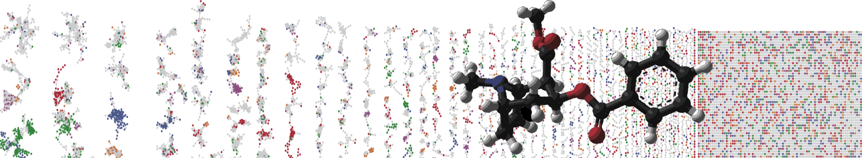


MASST – Querying All Public Metabolomics Data
HANDS ON
ENTER AUTHORS HERE
University of California - San Diego

Slide 2
Objectives and Data
Utilize GNPS MASST
Explore Public Data Occurrences
Link to the GNPS job: https://gnps.ucsd.edu/ProteoSAFe/status.jsp?task=fcac0f2f62fe493681d1ddbb61b05828

Slide 3
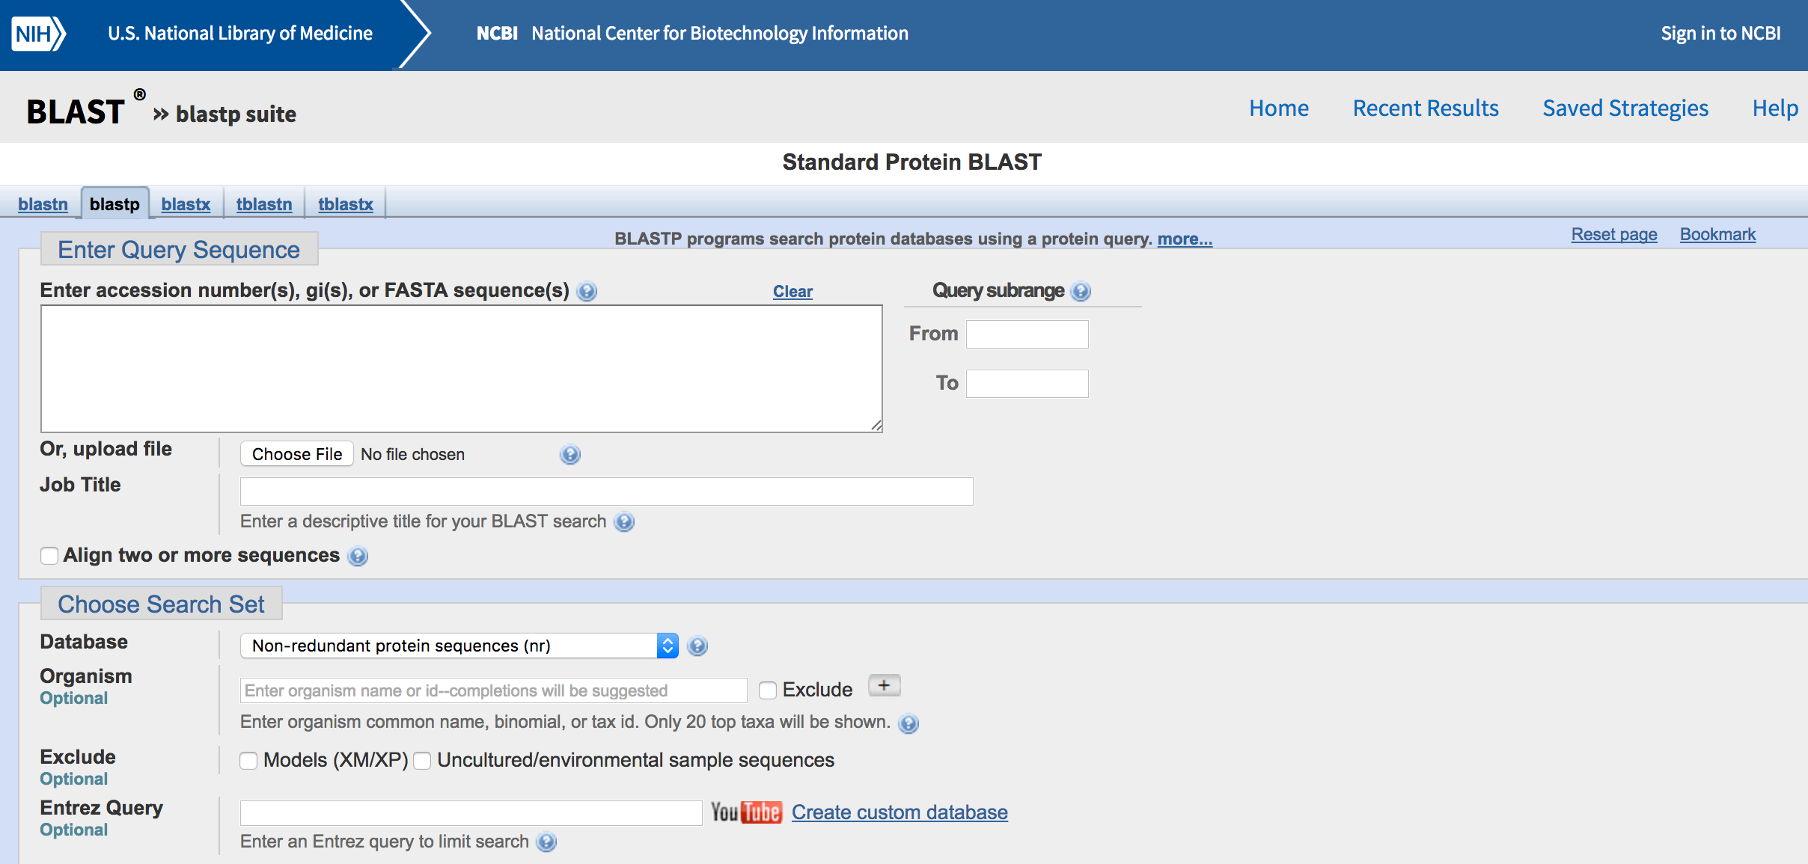
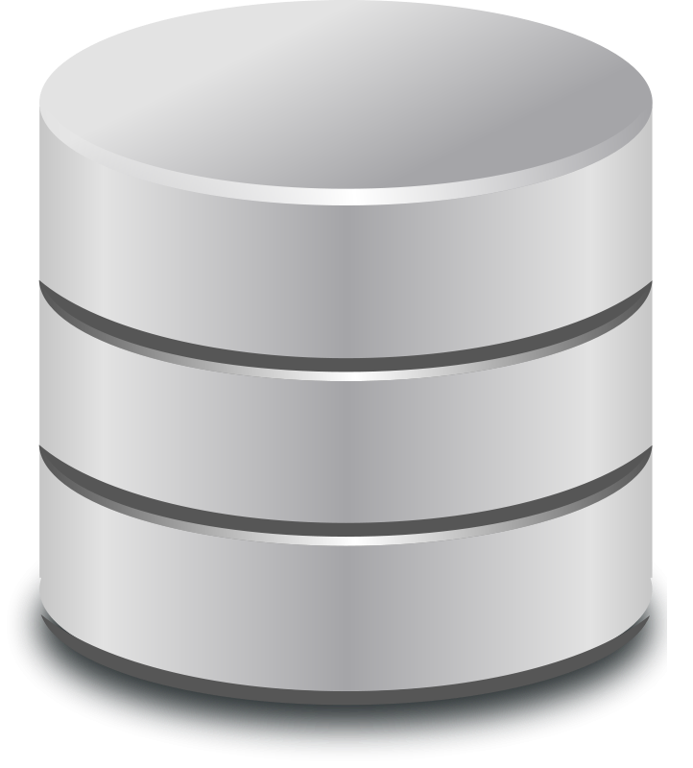
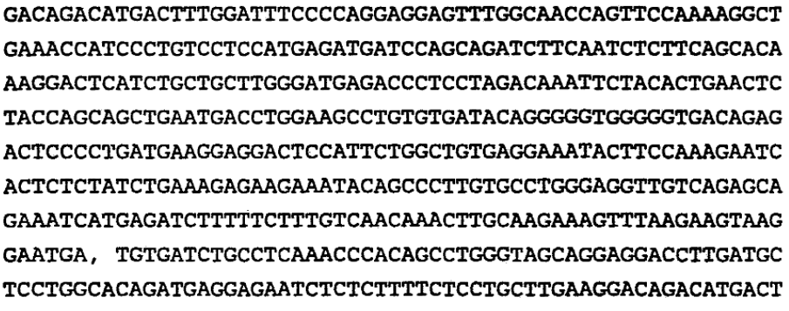

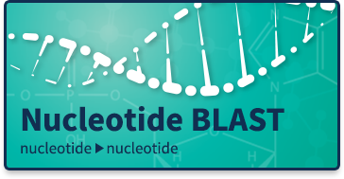
With sequencing we have come to expect the knowledge is accessible and retrievable
Not true for mass spectrometry
Database
Where is this seq.
found? any analogs?
Knowledgebase
Retrieval infrastructure

Slide 4
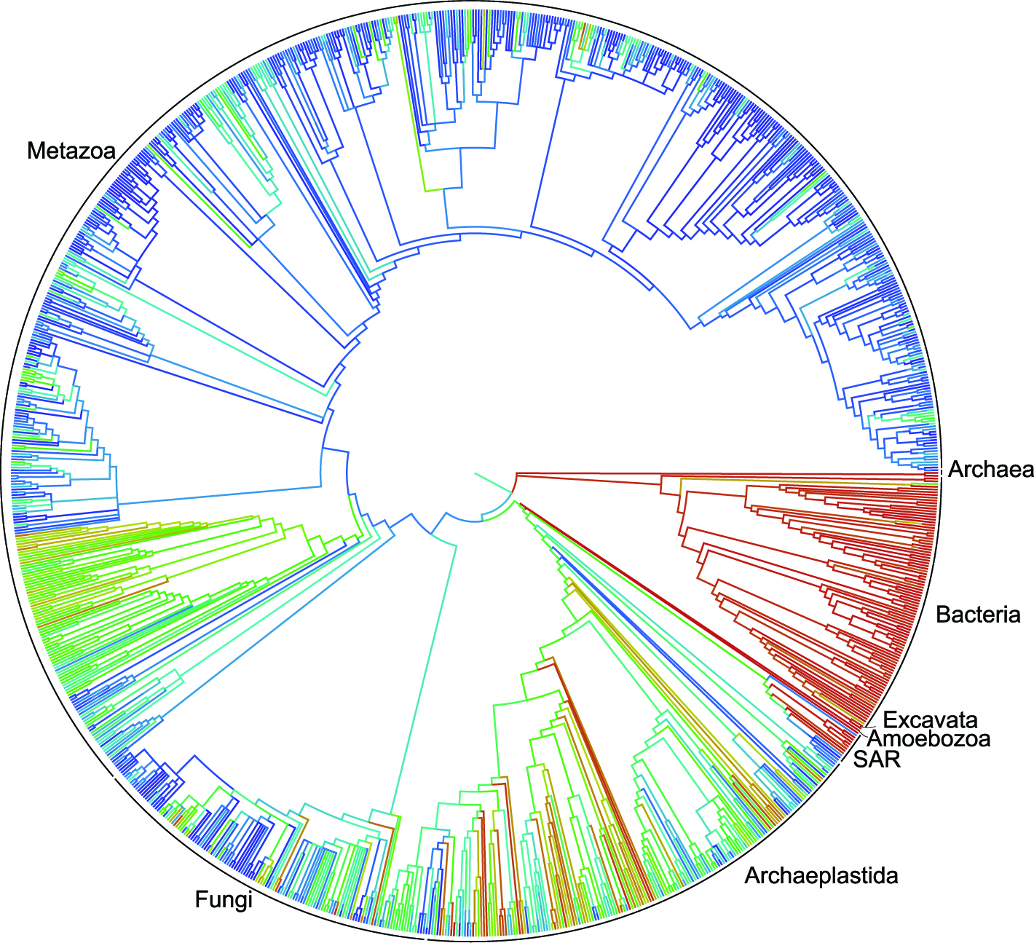
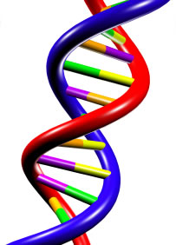
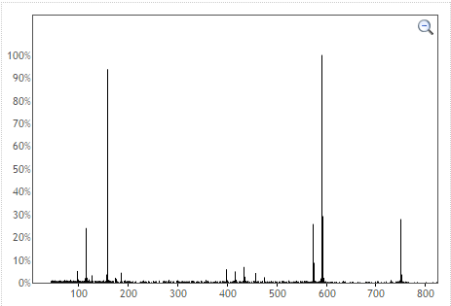

MASST – Mass Spectrometry Search Tool
BLAST
1000+ Datasets
100s Million Spectra
MASST
All Mass Spectrometry
Metabolomics/Natural Products
Datasets

Slide 5
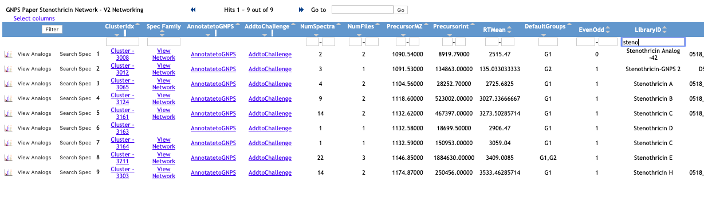
Search Directly From Molecular Networks
Steno

Slide 6
Search Directly From Molecular Networks
Steno
Stenothricin E MASST Query

Slide 7
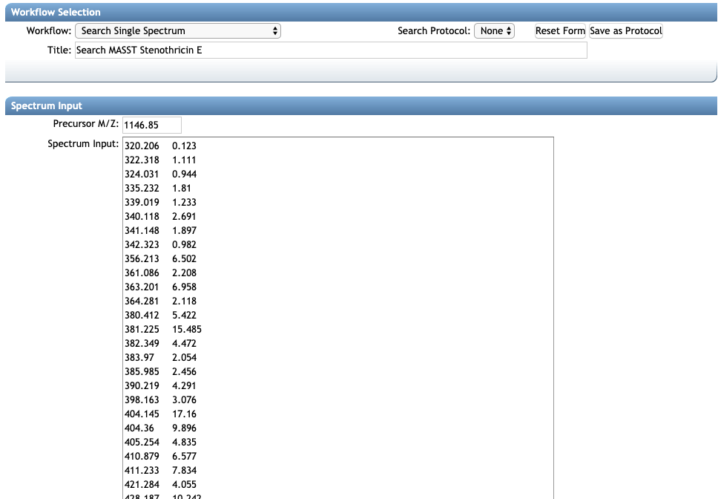
MASST Query Form
Precursor M/Z
Fragment Peaks

Slide 8
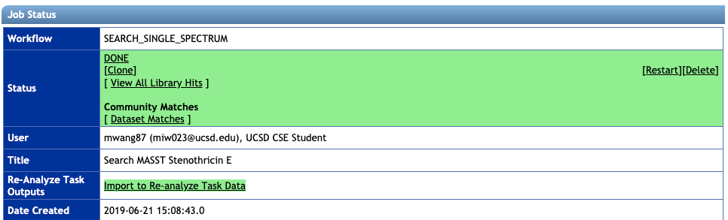
MASST Results
Interactive Links

Slide 9
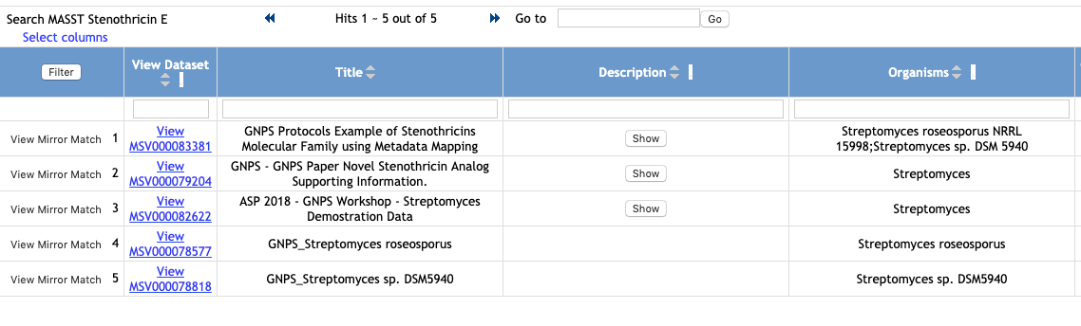
MASST Results – Datasets Compound Found
Interactive Links

Slide 10
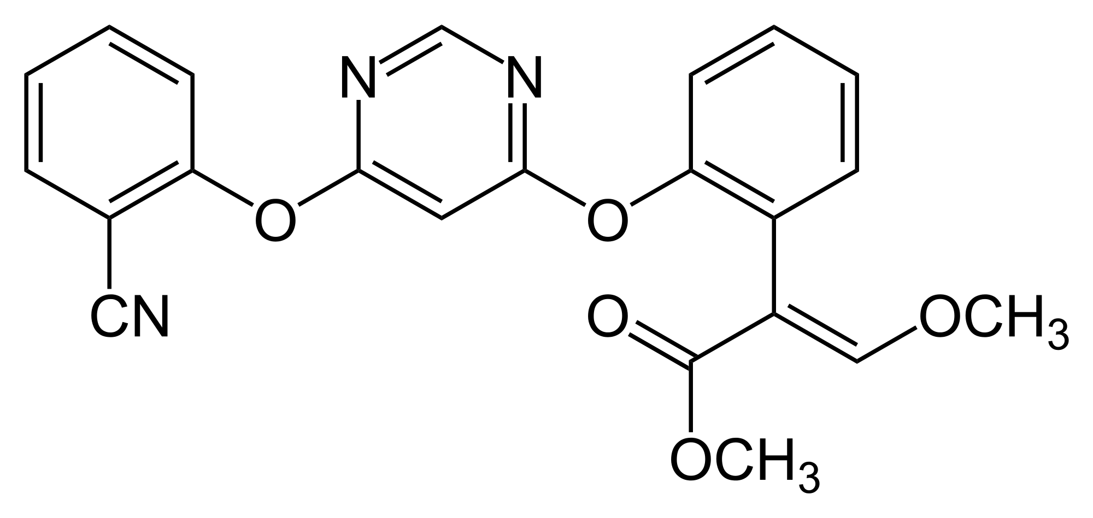
MASST Hands-on
Azoxystrobin MASST – Fungicide used in agriculture – where is this fungicide found?

Slide 11
Questions, Problems or Bugs?
Documentation: https://ccms-ucsd.github.io/GNPSDocumentation/
Forum: https://groups.google.com/forum/#!forum/molecular_networking_bug_reports
PRESENTER NAMES AND EMAILS HERE

